Slide 1
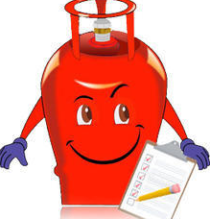
SOFTWARE ENGINEERING GAS AGENCY
Under the guidance of
DR. SHEIKH FAHAD AHMED

Slide 2
GROUP MEMBERS:-
MEMEMBERS_NAMES | MEMBERS_ IDS
B V V L N BHARGAV | 2110030150
JAINA VAMSHI | 2110030153
JATIN MISHRA | 2110030212
U SAI SUBRAHMANYAM | 2110030293

Slide 3
SRS DOCUMENT

Slide 4
LITERATURE REVIEW
The systems developed by some authors and scholars were reviewed adequately to discover gaps or issues that were not addressed. [3] designed and implemented gas booking system using a hardware called Radio Frequency Identity (RFID). The system worked successfully for the purpose but not cost effective. There was another hardware designed and implemented by [4] for gas booking and detection of leakages. [5] Implemented Arduino booking gas using Arduino board hardware All the reviewed literatures used hardware to implement the online booking of gas and this of course is not cost effective. In this study, a cost effective and reliable system will be designed and developed for online gas booking without the use of hardware.

Slide 5

Problem statement:-
Problem Statement Most of the LPG stations in Rural areas often experience long queue of people spending several hours waiting to buy gas. This problem of time wastage at the stations has persisted for several years.

Slide 6
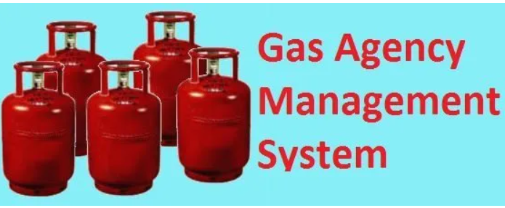
Existing solutions:-
Existing Solution1:-
Talking about the current system which presently used in the institutes is basically manually working or even if it is computerized restricted to a place or building thus all work of maintenance is also done in the same building. So, we can say that the Existing system of Gas Booking System works computerized in a building or manually with pen-paper.
ProjectSolution1:-
Through our project we can access the database from anywhere without any restrictions.
Existing Solution2:-
we can know the actual work of the ‘Bharat gas agency’ . The current work is not computerized system.
https://www.lovelycoding.org/online-gas-booking-system/ (Research Link)
ProjectSolution2:-(by this project, the process of ordering, billing, and stock maintenance for a gas agency can be processed easily )Computerized

Slide 7

Proposed Algorithm Design Technique
Q . What is the technique?
->We are going to follow 5 generic activites :-
1.COMMUNICATION
2.PLANNING
3.MODELLING
4.CONSTRUCTION
5.DEPLOYMENT

Slide 8
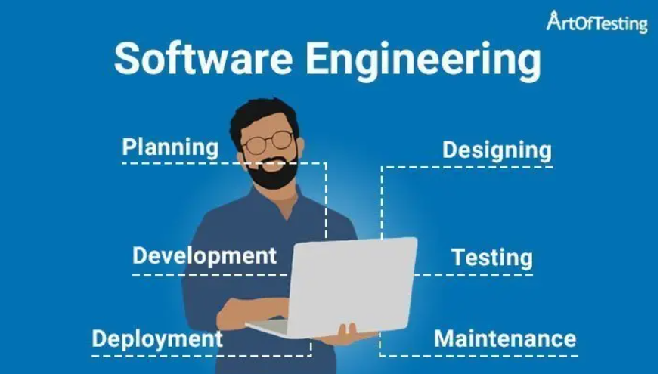
COMMUNICATION:-
What are the requirements?
Home delivery instead getting LPG cylinder from gas station .
Effortless ordering instead of waiting in long queues.
Easily usable website or application.
PLANNING:-
As per the Requirements we need to plan appropriately.
Create a map describing tasks including risks , resources , work product and work schedule.
Develop a schedule work according to it.
Develop a software using HTML,MYSQL.
Develop a design using STARUML.
We need to setup gas agency from where we can delivery “LPG”.

Slide 9
MODELLING AND CONSTRUCTION:-
We will create a sketch what it looks like architecturally.
We create a BLUEPRINT and try to implement it.
After implementation we make a prototype and test it.
Fix the bugs and improve the design.
DEPLOYEMENT:-
Last stage we provide delivery as per there usage we get the feedback.
And improve according to feedback.

Slide 10
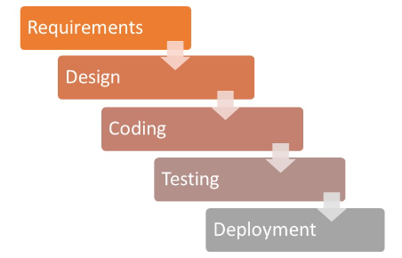
Software Development Method Waterfall Model

Slide 11
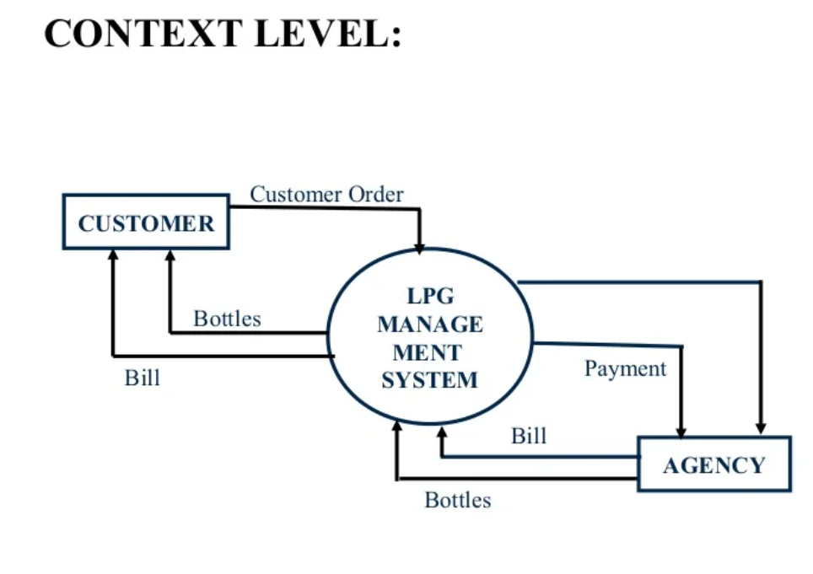
Work Flow Diagrams

Slide 12
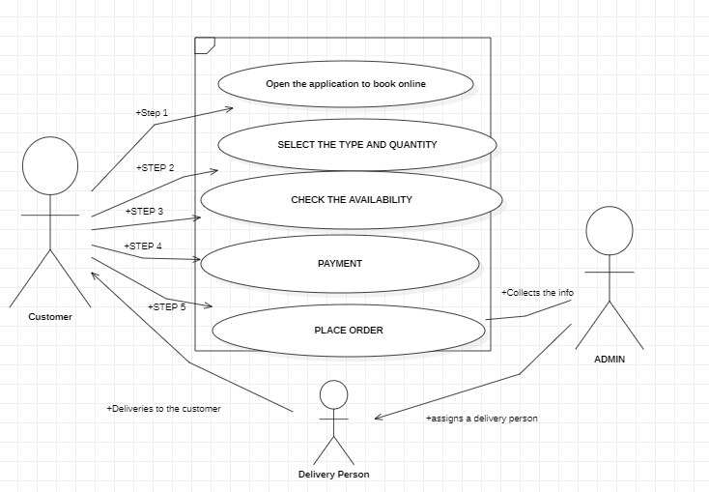
Use Case Diagram

Slide 13
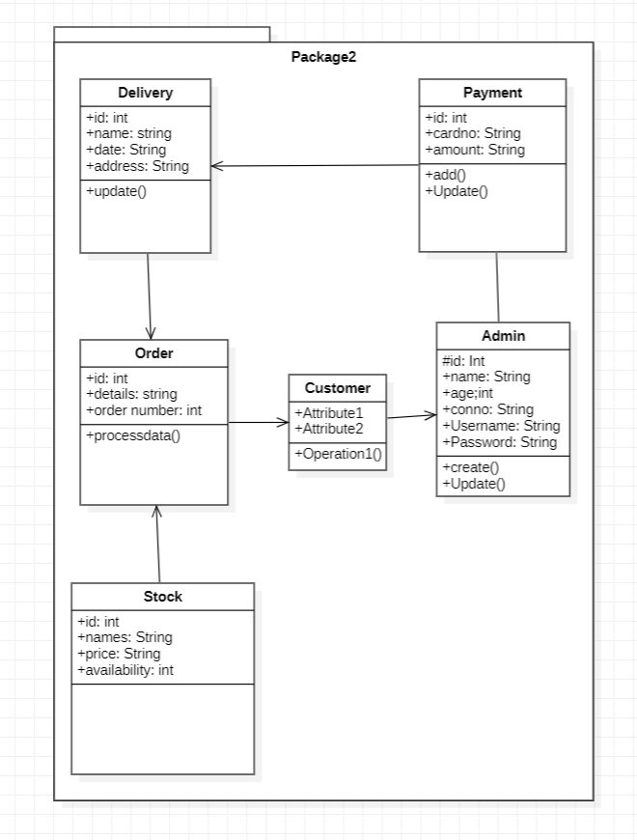
Class Diagram

Slide 14

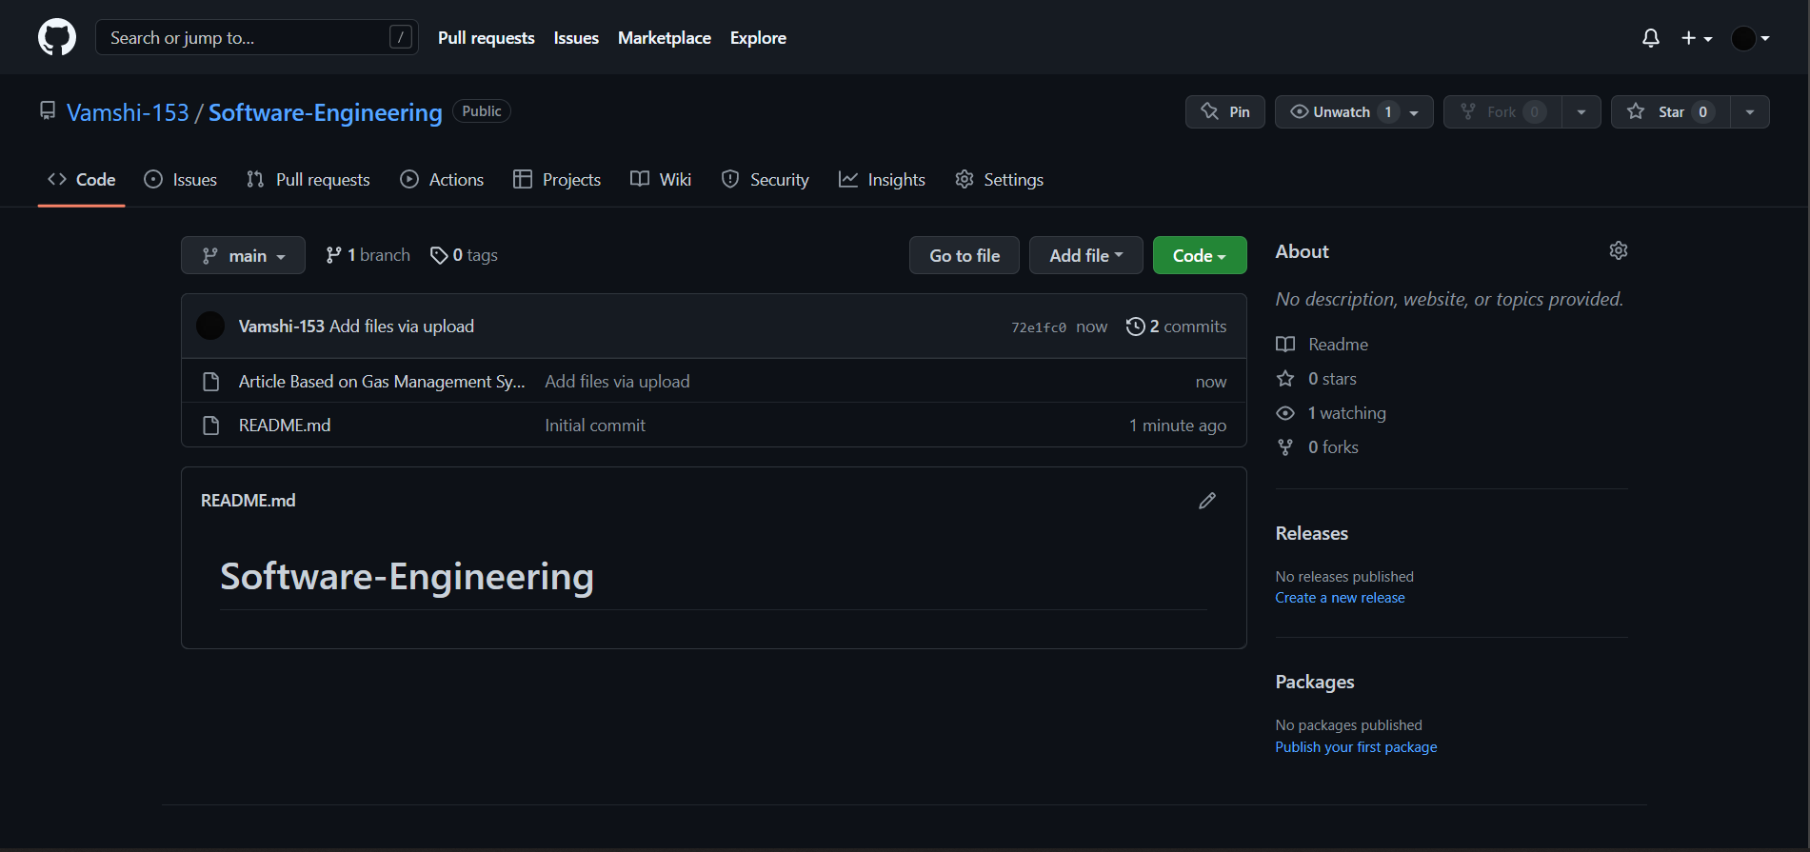
GITHUB SETUP:-

Slide 15
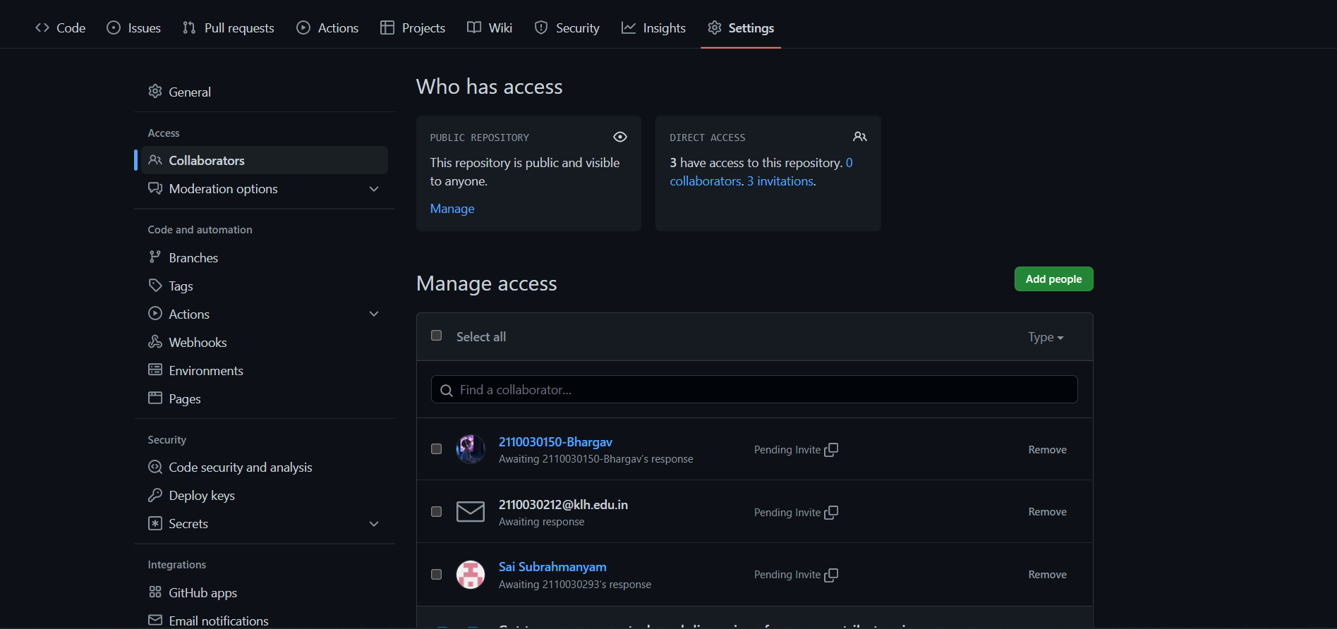
GITHUB SETUP:-

Slide 16
Division of work among the group members
Data Base Design – Bhargav (2110030150)
Web Designing – Vamshi (2110030153)
Data Base Modelling – Jatin (2110030212)
Web Page Modelling – Subrahmanyam (2110030293)

Slide 17
THANK YOU

